Slide 1
NLP

Slide 2
Introduction to NLP
Question Answering
[includes slides by Talley Amir]

Slide 3
What is Question Answering?
Question answering (QA), is the problem of systematically deriving an answer to a question asked in a natural language based on a knowledge source.
Hermann, Karl M. “Deep Learning for Natural Language Processing: Question Answering.” Google DeepMind. 4 March 2017.

Slide 4
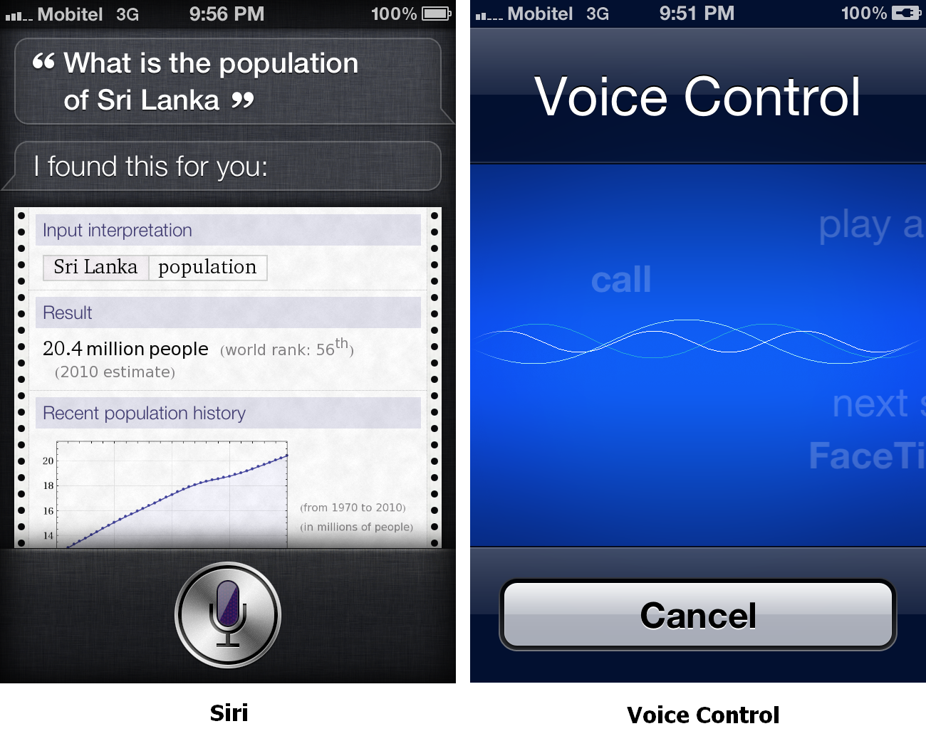
Siri

Slide 5
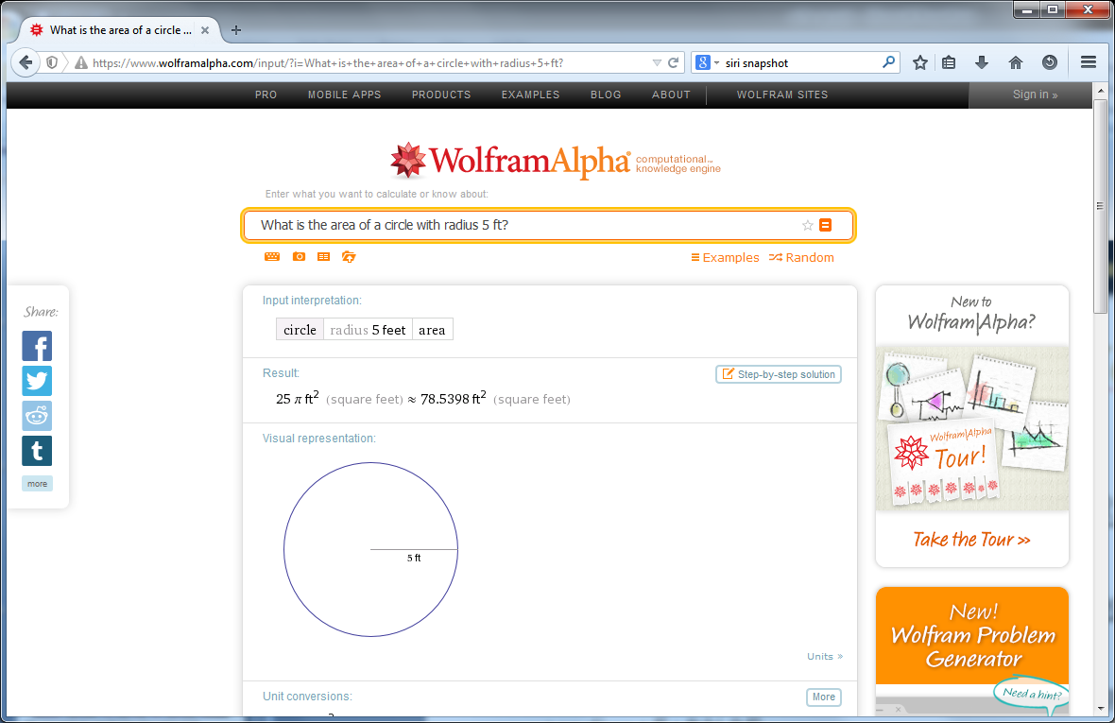
WolframAlpha

Slide 6
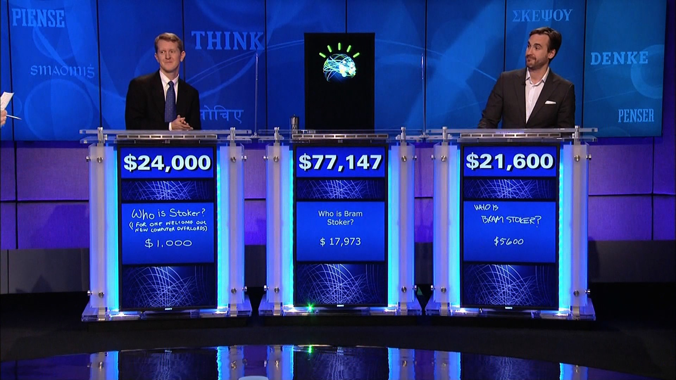
IBM’s Watson
http://www.geekwire.com/2013/ibm-takes-watson-cloud/

Slide 7
People Ask Questions Online
Excite corpus
2,477,283 queries (one day’s worth)
8.4% of them are questions
43.9% factual (what is the country code for Belgium)
56.1% procedural (how do I get out of debt) or other

Slide 8
The Excite Corpus
In what year did baseball become an offical sport?
how do i get out of debt?
Where can I found out how to pass a drug test?
When is the Super Bowl?
who is California's District State Senator?
where can I buy extra nibs for a foutain pen?
what time is it in west samoa?
Where can I buy a little kitty cat?
what are the symptoms of attention deficit disorder?
Where can I get some information on Michael Jordan?
How does the character Seyavash in Ferdowsi's Shahnameh exhibit characteristics of a hero?
When did the Neanderthal man live?
Which Frenchman declined the Nobel Prize for Literature for ideological reasons?
Notes:
Each question can have multiple answers

Slide 9
AOL Corpus Questions
what does cerebral cortical atrophy mean
what fraction is closest to pi
what is the highest calories consumed by a person in a 24 hor period
what happens to limewater in the presence of carbon dioxide
what language is numa numa in
who discovered saturn
who discovered the gene for huntington's disease
who is the daugther of indian sitar maestro ravi Shankar
who invented marshmallow sandwich cookies
who invented lithograph
who was the first michigan football player to put on the cover of a video game
who invented smallpox vaccine
when was the berlin wall torn down
when was yahoo launched
when was the wedding march by mendelssohn composed
when was the declaration of independence signed
when did france become a republic
when was alexander the great born
which fish contains low mercury
when is the youngest a minor can move out of thier parents house in texas
when should take a child to see an psychologist
what hormone imbalance could mimic pregnancy symptoms

Slide 10
What is Question Answering?
Information retrieval (IR)-based QA
Uses phrases in the question to search for keywords in vast data sources (e.g. documents in a reserve, websites on the Internet) that may contain the answer to the question. The answer-candidates are then ranked based on various metrics pertaining to the quality and relevance of the answers.
Knowledge-based QA
Translates the question into a semantic representation compatible with a database wherein the answer to the question lies. The semantic representation is then made as a query to the database, and the query-answer is then converted to a natural-language response.
Jurafsky, Daniel. Martin, James H. “Speech and Language Processing.” Third Edition. 15 August 2018: p. 376.

Slide 11
Question Type Taxonomy
Question Types
Yes/no vs. wh-
Factual vs. procedural
Single answer vs. multiple answers
Objective vs. subjective
Context-specific (personalized) vs. generic
Known answer in the collection, y/n

Slide 12
Older Systems (pre-TREC)
BASEBALL (Green et al., 1961)
Baseball
ELIZA (Weizenbaum 1966)
Dialogue, Therapist
SHRDLU (Winograd 1972)
Blocks world
LUNAR (Woods, 1973)
Lunar rocks
Murax (Kupiec 1993)
Open-domain, encyclopedia-based
START (Katz 1997)
Open-domain, web-based
Deep Red (Hirschman & al. 1999)
Reading comprehension
Jupiter (Zue et al., 2000)
Spoken questions

Slide 13
Eliza (Weizenbaum 1966)
Eliza plays a therapist
and doesn’t really answer questions ☺
Simple pattern matching
Sample dialogue
E: I am the psychotherapist. Please, describe your problems.
P: I am always tired.
E: Why do you say you are always tired?
P: Because I cannot sleep.
E: Is it because you cannot sleep that you came to me?
P: Yes, help me please.
E: Earlier you said you cannot sleep?

Slide 14
Lunar (Woods et al., 1972)
Lunar Sciences Natural Language Information System
Apollo 11 moon rocks
Questions in English
Components
a general-purpose ATN (augmented transition network) grammar for English
a procedural-semantics framework for semantic interpretation
mapping from the syntactic grammar to a logic representation
3,500 word dictionary
13,000 entries in the knowledge base
Lunar answered 78% of sentences asked by geologists at 1971 Lunar Rocks conference
How many breccias contain olivine?
What are they?

Slide 15
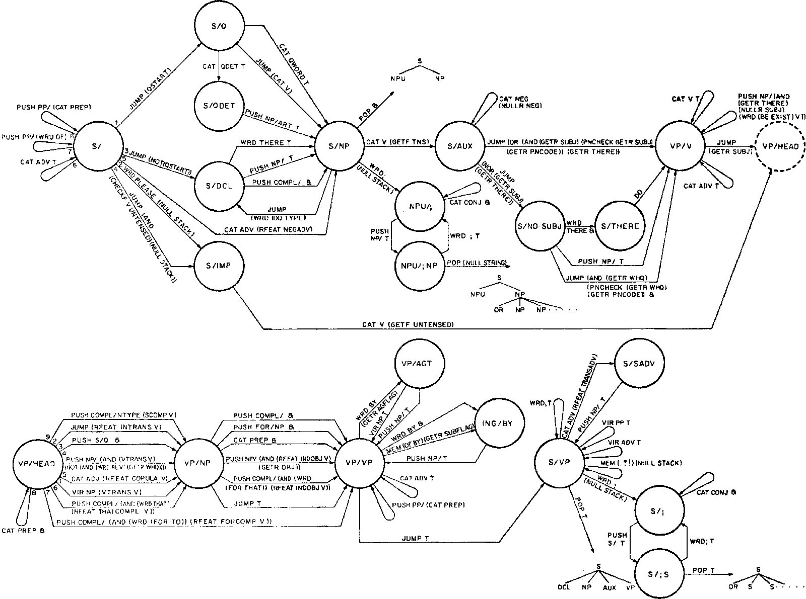
Lunar Grammar Fragment

Slide 16
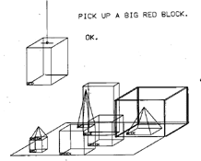
SHRDLU (Winograd 1972)
Simple questions about the blocks world
Person: Pick up a big red block.
Computer: OK.
Person: Grasp the pyramid.
Computer: I don't understand which pyramid you mean.
Person (changing their mind): Find a block which is taller than the one you are holding and put it into the box.
Computer: By "it", I assume you mean the block which is taller than the one I am holding.
Computer: OK.
Person: What does the box contain?
Computer: The blue pyramid and the blue block.
Person: What is the pyramid supported by?
Computer: The box.
Person: How many blocks are not in the box?
Computer: Four of them.
Person: Is at least one of them narrower than the one which I told you to pick up?
Computer: Yes, the red cube.
http://hci.stanford.edu/~winograd/shrdlu/

Slide 17
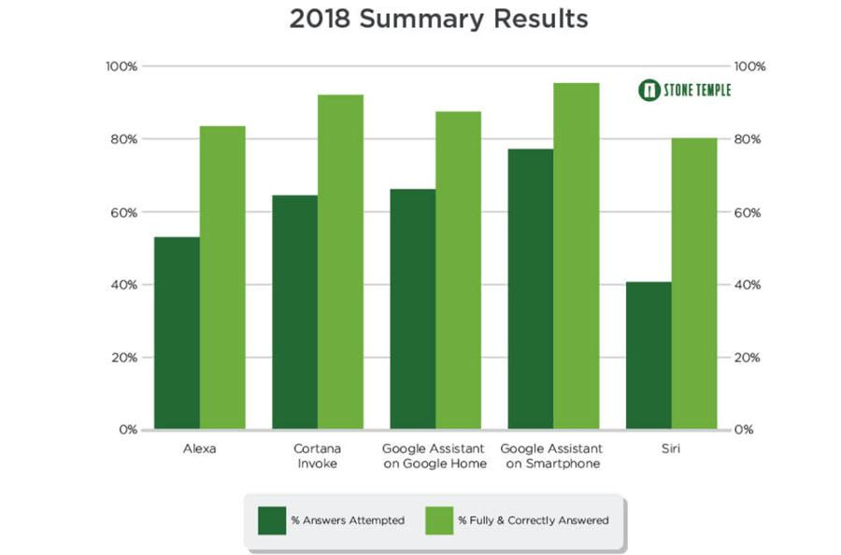
Virtual Assistants
Applications:
Command execution.
Play music, set an alarm
Simple question answering.
What is the weather like today?
Performance:

Slide 18
Introduction to NLP
Evaluation of QA

Slide 19
What is Question Answering?
Metrics of successful QA modeling:
Relevance
Correctness
Conciseness
Completeness
Coherence
Justification
Current limitations:
Breadth versus depth
Pasupat, Panupong. “WikiTableQuestions: A Complex Real-World Question Answering Dataset.” The Stanford NLP Group. 11 February 2016.
L. Hirschman and R. Gaizauskas, ``Natural language question answering: the view from here,” JNLE, vol. 7, no. 4, pp. 275-300, 2001.

Slide 20
The TREC Q&A evaluation
Run by NIST
Voorhees and Tice 1999, 2000
2GB of input
AQUAINT corpus
200 questions in 1999
693 questions in 2000
Essentially fact extraction
Who was Lincoln’s secretary of state?
What does the Peugeot company manufacture?
Assumptions
Questions are based on text
Answers are assumed to be present
Systems return five passages of 50 or 250 bytes
After 2002, only a single passage of 50 bytes + confidence score + NIL
No inference needed

Slide 21
TREC
What date in 1989 did East Germany open the Berlin Wall?
Nov 9
Who was Johnny Mathis' high school track coach?
Lou Vasquez
What is the shape of a porpoises' tooth?
spade-shaped
What is the number of buffaloes thought to have been living in North America when Columbus landed in 1492?
60 million
The Faroes are a part of what northern European country?
Denmark
The symptoms of Parkinson's disease are linked to the demise of cells in what area of the brain?
substantia nigra
What was the date of the Chelsea flower show in 1992?
May 18
What hotel was used for a setting of the Agatha Christie novel, "And Then There Were None"?
Burgh Island Hotel
What year was the Magna Carta signed?
1215
Who was Lincoln's Secretary of State?
William Seward
How long does it take to fly from Paris to New York in a Concorde?
3 1/2 hours

Slide 22
TREC 1999 – Test Questions
Who is the author of the book, "The Iron Lady: A Biography of Margaret Thatcher"?
What was the monetary value of the Nobel Peace Prize in 1989?
What does the Peugeot company manufacture?
How much did Mercury spend on advertising in 1993?
What is the name of the managing director of Apricot Computer?
Why did David Koresh ask the FBI for a word processor?
What debts did Qintex group leave?
What is the name of the rare neurological disease with symptoms such as: involuntary movements (tics), swearing, and incoherent vocalizations (grunts, shouts, etc.)?
How far is Yaroslavl from Moscow?
Name the designer of the shoe that spawned millions of plastic imitations, known as "jellies".
Who was President Cleveland's wife?
How much did Manchester United spend on players in 1993?
How much could you rent a Volkswagen bug for in 1966?
What country is the biggest producer of tungsten?
When was London's Docklands Light Railway constructed?
What two US biochemists won the Nobel Prize in medicine in 1992?
How long did the Charles Manson murder trial last?
Who was the first Taiwanese President?
Who was the leader of the Branch Davidian Cult confronted by the FBI in Waco, Texas in 1993?
Where is Inoco based?
Who was the first American in space?
When did the Jurassic Period end?
When did Spain and Korea start ambassadorial relations?
When did Nixon visit China?
Who was the lead actress in the movie "Sleepless in Seattle"?
What is the name of the "female" counterpart to El Nino, which results in cooling temperatures and very dry weather?
What is the brightest star visible from Earth?
What are the Valdez Principles?

Slide 23
Evaluation
MRR
Mean Reciprocal Rank
Introduced by TREC
Example
What is the capital of Canada?
1.Toronto, 2.Ottawa, 3.Albany, 4.Philadelphia, 5.Ottawa
Correct answer ranks = 2, 5 (highest rank = 2)
MRR = 1/2 = 0.5
TRR = 1/2 + 1/5 = 0.7 = total reciprocal rank
Later years
Confidence-weighted score

Slide 24
Other Types of Questions
Definitional
What is a boll weevil?
List
Which states signed the US Declaration of Independence?
Crosslingual
E.g., questions in Spanish, documents in English
Series
Next slide

Slide 25
TREC Series Questions
What are prions made of?
Who discovered prions?
What researchers have worked with prions?
Who is the lead singer/musician in Nirvana?
Who are the band members?
When was the band formed?
What is their biggest hit?
What are their albums?
What style of music do they play?
What industry is Rohm and Haas in?
Where is the company located?
What is their annual revenue?
How many employees does it have?
What kind of insect is a boll weevil?
What type of plant does it damage?
What states have had problems with boll weevils?

Slide 26
Question Answering
System Architecture

Slide 27
General QA Architecture
[Jurafsky and Martin book]

Slide 28
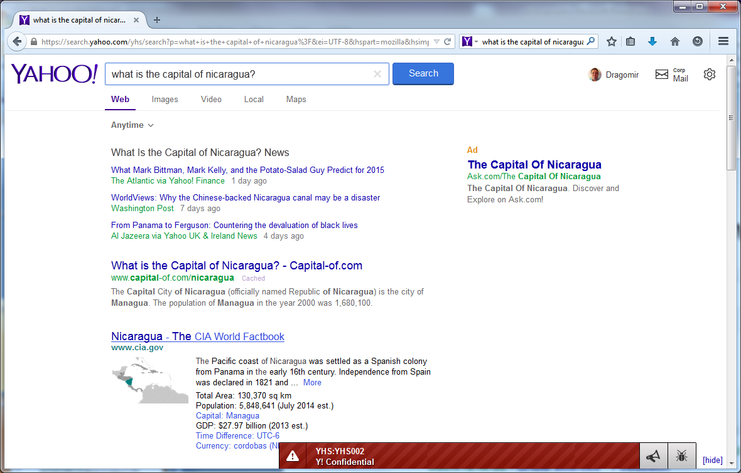
System Architecture
Many questions can be answered by traditional search engines

Slide 29
What is the Largest City in Northern Afghanistan?
... Afghanistan, Kabul, 2,450 ... Administrative capital and largest city (1997 est ... Undetermined. Panama, Panama City, 450,668. ... of the Gauteng, Northern Province, Mpumalanga ... www.infoplease.com/cgi-bin/id/A0855603
... died in Kano, northern Nigeria's largest city, during two days of anti-American riots led by Muslims protesting the US-led bombing of Afghanistan, according to ... www.washingtonpost.com/wp-dyn/print/world/
... air strikes on the city. ... the Taliban militia in northern Afghanistan in a significant blow ... defection would be the largest since the United States ... www.afgha.com/index.php - 60k
... Kabul is the capital and largest city of Afghanistan. . ... met. area pop. 2,029,889), is the largest city in Uttar Pradesh, a state in northern India. . ... school.discovery.com/homeworkhelp/worldbook/atozgeography/ k/k1menu.html
... Gudermes, Chechnya's second largest town. The attack ... location in Afghanistan's outlying regions ... in the city of Mazar-i-Sharif, a Northern Alliance-affiliated ... english.pravda.ru/hotspots/2001/09/17/
... Get Worse By RICK BRAGG Pakistan's largest city is getting a jump on the ... Region: Education Offers Women in Northern Afghanistan a Ray of Hope. ... www.nytimes.com/pages/world/asia/
... within three miles of the airport at Mazar-e-Sharif, the largest city in northern Afghanistan, held since 1998 by the Taliban. There was no immediate comment ... uk.fc.yahoo.com/photos/a/afghanistan.html

Slide 30
System Components
Source identification
semi-structured vs. text sources
Query modulation
best paraphrase of a NL question given the syntax of a search engine
Example: Who wrote Hamlet → author | wrote Hamlet
Document retrieval
Sentence ranking
n-gram matching, Okapi
Answer extraction
question type classification
phrase chunking
Answer ranking
question type, proximity to query words, frequency

Slide 31
What is the largest city in Northern Afghanistan?
Query modulation
(largest OR biggest) city “Northern Afghanistan”
Document retrieval
www.infoplease.com/cgi-bin/id/A0855603 www.washingtonpost.com/wp-dyn/print/world/
Sentence ranking
Gudermes, Chechnya's second largest town … location in Afghanistan's outlying regions
within three miles of the airport at Mazar-e-Sharif, the largest city in northern Afghanistan
Answer extraction
Gudermes
Mazer-e-Sharif
Answer ranking
Mazer-e-Sharif
Gudermes

Slide 32
Question Type Classification
Can help find the right answers in the text
Example
Who wrote Anna Karenina?
Looking for a PERSON/INDIVIDUAL/WRITER

Slide 33
SYN-classes (IBM AnSel)
QA-token
Question type
Example
PLACE
Where?
In the Rocky Mountains
COUNTRY
Where? What country?
United Kingdom
STATE
Where? What state?
Massachusetts
PERSON
Who?
Albert Einstein
ROLE
Who?
Doctor
NAME
Who? What? Which?
The Shakespeare Festival
ORG
Who? What?
The U.S. Post Office
DURATION
How long?
For 5 centuries
AGE
How old?
30 years old
YEAR
When? What year?
1999
TIME
When? What time?
In the afternoon
DATE
When? What date?
July 4th, 1776
VOLUME
How big? How large?
3 gallons
AREA
How big? How large?
4 square inches
LENGTH
How long? How big?
3 miles
WEIGHT
How heavy? How big?
25 tons
NUMBER
How many?
1,134.5
RATE
How much? What percentage?
50 per cent
MONEY
How much?
4 million dollars

Slide 34
UIUC Question Types
ENTITY: entities
animal: animals
body: organs of body
color: colors
creative: inventions, books and other creative pieces
currency: currency names
dis.med.: diseases and medicine
event: events
food: food
instrument: musical instrument
lang: languages
letter: letters like a-z
other: other entities
plant: plants
product: products
religion: religions
sport: sports
substance: elements and substances
symbol: symbols and signs
technique: techniques and methods
term: equivalent terms
vehicle: vehicles
word: words with a special property
ABBREVIATION: abbreviation
abb: abbreviation
exp: expression abbreviated
DESCRIPTION: description and abstract concepts
definition: definition of sth.
description: description of sth.
manner: manner of an action
reason: reasons
HUMAN: human beings
group: a group or organization of persons
ind: an individual
title: title of a person
description: description of a person
LOCATION: locations
city: cities
country: countries
mountain: mountains
other: other locations
state: states
NUMERIC: numeric values
code: postcodes or other codes
count: number of sth.
date: dates
distance: linear measures
money: prices
order: ranks
other: other numbers
period: the lasting time of sth.
percent: fractions
speed: speed
temp: temperature
size: size, area and volume
weight: weight

Slide 35
UIUC Examples
NUM:date
When did Rococo painting and architecture flourish ?
LOC:country
What country 's national passenger rail system is called Via ?
HUM:ind
Who invented Make-up ?
DESC:desc
What is the origin of the word `` attic '' ?
DESC:desc
What did Delilah do to Samson 's hair ?
ENTY:animal
What kind of animals were in the Paleozoic era ?
HUM:ind
Which of the following was Rhodes Scholar ?
HUM:ind
Who comprised the now-defunct comic book team known as the Champions ?
DESC:manner
How do you make a paintball ?
LOC:state
What U.S. state is Fort Knox in ?
ENTY:animal
What is a female rabbit called ?
LOC:mount
Where is the highest point in Japan ?
DESC:desc
Where do chihuahuas come from ?
LOC:other
Where does Barney Rubble go to work after he drops Fred off in the “Flintstones” cartoon series?

Slide 36
Techniques for Question Classification
Classification task
Use standard techniques such as SVM, NB
Regular expressions
WHO is|was -> PERSON
WHICH STATE -> STATE

Slide 37
Passage Retrieval
Features
Proper nouns that match the query
Near each other
Entities that match the expected answer type

Slide 38
Answer Retrieval
Use NER to identify the matching phrases
E.g., “January 1, 1951” as a DATE
Features
Distance to query words
Answer type
Wordnet similarity
Redundancy

Slide 39
Redundancy
When did French revolutionaries storm the Bastille?
The storming of the Bastille occurred in Paris on the morning of 14 July 1789
The storming of the Bastille, 14 July 1789
The storming of the Bastille prison on July 14th 1789 was an event that paved the way to further civil disorder and upheaval in France.
French revolutionaries storm Bastille, 1789
The storming of the Bastille (Louis XVI's prison) by French revolutionaries took place on July 14th, 1789
Who killed Mahathma Gandhi?
Mohandas Karamchand Gandhi (often called Mahatma Gandhi) was assassinated on 30 January 1948, shot at point-blank range by Nathuram Godse.
Nathuram Godse killed Gandhi
Godse killed Gandhi
Mahatma Gandhi was assassinated on 30 January 1948, shot at point-blank range by Nathuram Godse
Mohandas Gandhi was shot dead by Nathuram Godse, a Hindu extremist
Godse assassinated Mahatma Gandhi on January 30, 1948, approaching him during the evening prayer, bowing, and shooting him three times at close range with a Beretta semi-automatic pistol.

Slide 40
Redundancy (2/2)
What is the capital of Spain?
Madrid is the capital of Spain
En route to Spain's capital of Madrid
Madrid, Spain's capital city is situated almost at the geographical epicentre of the country
The capital of Spain is Madrid
Madrid, Spain's sunny capital
Madrid became Spain's capital
In 1561, it was elevated to status as Spain's capital city
Madrid has been the capital of Spain since 1562
Madrid, the physical and cultural capital of Spain

Slide 41
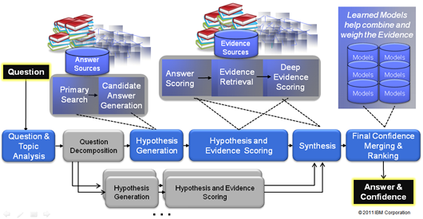
IBM Watson Architecture
[Ferrucci et al. 2011]

Slide 42
Watson (Ferrucci et al. 2010)
Jeopardy winner (2011)
Architecture
Uses "DeepQA": a technology that enables computer systems to directly and precisely answer natural language questions over an open and broad range of knowledge
10 racks of IBM Power 750 servers running Linux
16 terabytes of RAM
2,880 processor cores
Capable of operating at 80 teraflops.
Mostly in Java but also some C++ and Prolog
Integrated using UIMA
Ferrucci et al. 2010. Building Watson: An Overview of the DeepQA Project. AI Magazine. Fall 2010. 59-79.
http://www.pcmag.com/article2/0,2817,2380351,00.asp
http://blog.reddit.com/2011/02/ibm-watson-research-team-answers-your.html

Slide 43
Watson (Ferrucci et al. 2011)
Knowledge sources
200 million pages of structured and unstructured content consuming four terabytes of disk storage
Including Wikipedia, WordNet, Yago
Betting strategy
Buzz if at least 50% certain
Performance
Watson answers 66 correct and 9 incorrect.
Watson's two day winning streak was $77,147. Ken Jennings ended with $24,000 and Brad Rutter with $21,600.
http://www.quora.com/What-questions-were-asked-in-the-Jeopardy-episode-involving-Watson
http://theswimmingsubmarine.blogspot.com/2011/02/how-ibms-deep-question-answering.html
http://www.theatlantic.com/technology/archive/2011/02/is-it-time-to-welcome-our-new-computer-overlords/71388/

Slide 44
Watson (Ferrucci et al. 2011)
Question types
2,500 of them
200 of them are very common
Jeopardy Question Archive
http://j-archive.com/

Slide 45
Watson on Jeopardy
Sample questions
On December 8, 2008 this national newspaper raised its newsstand pice by 25 cents to $1
USA Today
In 2010 this former first lady published the memoir "Spoken From the Heart“
Laura Bush
This person is appointed by a testator to carry out the directions & requests in his will
Executor
Familiarity is said to breed this, from the Latin for "Despise“
Contempt
As of 2010, Croatia & Macedonia are candidates but this is the only former Yugoslav republic in the EU
Slovenia
The ancient "Lion of Nimrud" went missing from this city's national museum in 2003 (along with a lot of other stuff)
Baghdad
It's just a bloody nose! You don't have this hereditary disorder once endemic to European royalty
Haemophilia
It's Michelangelo's fresco on the wall of the Sistine Chapel, depicting the saved and the damned
The Last Judgement
She "Died in the church and was buried along with her name. Nobody came“
Eleanor Rigby
A camel is a horse designed by this
Committee

Slide 46
Watson Videos
IBM's Watson Supercomputer Destroys Humans in Jeopardy
https://www.youtube.com/watch?v=WFR3lOm_xhE
"What is IBM Watson?" 7 Videos from the Jeopardy! Era
http://mentalfloss.com/article/51543/what-ibm-watson-7-videos-jeopardy-era

Slide 47
(SQuAD): 100,000+ Questions for Machine Comprehension of Text
Application
Reading comprehension, specifically applied to question-answer pairs from Wikipedia articles (cultivated in this dataset).
Challenge
Manually develop a large reading comprehension dataset of quality questions and answers, and derive a model for learning on that dataset.
Implementation
This model uses both dependency and constituency trees, as well as a strong logistic regression model.
Rajpurkar, Pranav. Zhang, Jian. Lopyrev, Konstantin. Liang, Percy. “SQuAD: 100,000+ Questions for Machine Comprehension of Text.” Stanford University, Computer Science Department. 11 October 2016.

Slide 48
(SQuAD): 100,000+ Questions for Machine Comprehension of Text
Existing Datasets:
Hirschman et al. (1999)
Later improved: Riloff and Thelen (2000); Ng et al. (2000)
Richardson et al. (2013): MCTest
Later improved: Narasimhan and Barzilay (2015); Sachan et al. (2015); Wang et al. (2015)
Both data sets are too small to extend to more “expressive” QA modeling systems.
Rajpurkar, Pranav. Zhang, Jian. Lopyrev, Konstantin. Liang, Percy. “SQuAD: 100,000+ Questions for Machine Comprehension of Text.” Stanford University, Computer Science Department. 11 October 2016.

Slide 49
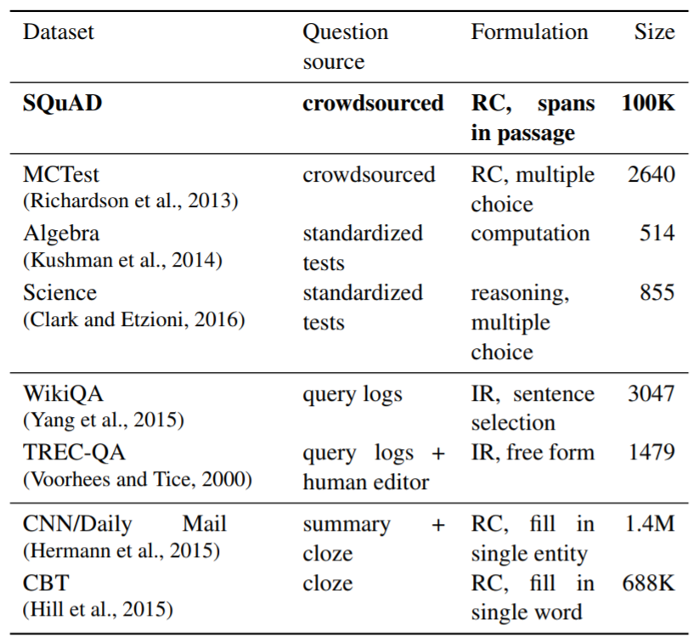
(SQuAD): 100,000+ Questions for Machine Comprehension of Text
Rajpurkar, Pranav. Zhang, Jian. Lopyrev, Konstantin. Liang, Percy. “SQuAD: 100,000+ Questions for Machine Comprehension of Text.” Stanford University, Computer Science Department. 11 October 2016.
Notes:
(Table): “A survey of several reading comprehension and question answering datasets. SQuAD is much larger than all datasets except the semi-synthetic cloze-style datasets, and it is similar to TREC-QA in the open-endedness of the answers.” Ibid.

Slide 50
(SQuAD): 100,000+ Questions for Machine Comprehension of Text
How questions were formulated:
Randomly selected 536 of the 10,000 most visited Wikipedia pages.
Passages of sufficient length were divided into: training set, development set, or test set.
Crowdworkers generated questions that could be answered with a span of text from the passage.
Other crowdworkers were then used to select alternate answer choices (spans from the text)
Rajpurkar, Pranav. Zhang, Jian. Lopyrev, Konstantin. Liang, Percy. “SQuAD: 100,000+ Questions for Machine Comprehension of Text.” Stanford University, Computer Science Department. 11 October 2016.

Slide 51
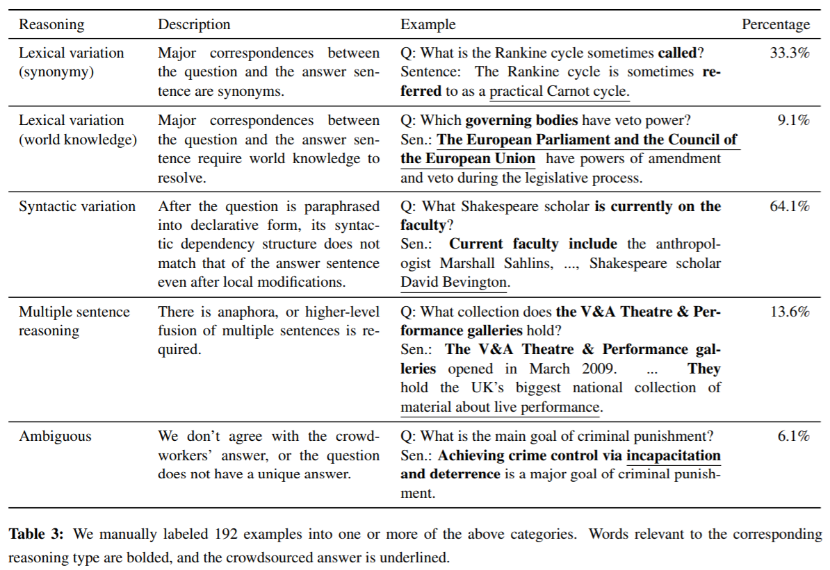
(SQuAD): 100,000+ Questions for Machine Comprehension of Text
Rajpurkar, Pranav. Zhang, Jian. Lopyrev, Konstantin. Liang, Percy. “SQuAD: 100,000+ Questions for Machine Comprehension of Text.” Stanford University, Computer Science Department. 11 October 2016.
Notes:
(Table): “A survey of several reading comprehension and question answering datasets. SQuAD is much larger than all datasets except the semi-synthetic cloze-style datasets, and it is similar to TREC-QA in the open-endedness of the answers.” Ibid.

Slide 52
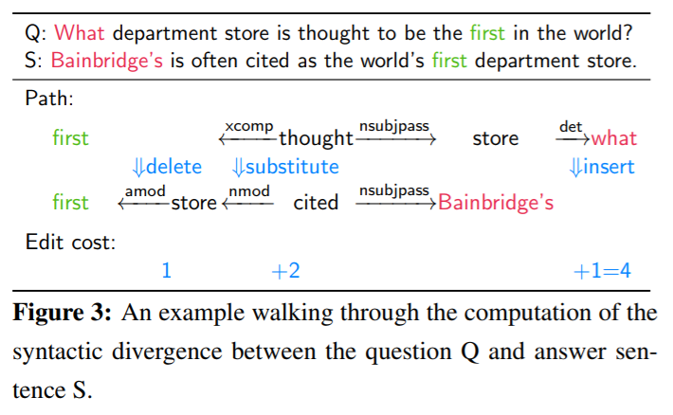
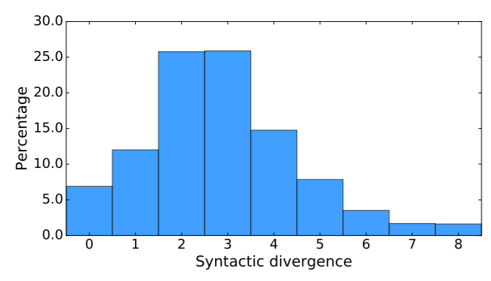
(SQuAD): 100,000+ Questions for Machine Comprehension of Text
Measurement of syntactic divergence:
Rajpurkar, Pranav. Zhang, Jian. Lopyrev, Konstantin. Liang, Percy. “SQuAD: 100,000+ Questions for Machine Comprehension of Text.” Stanford University, Computer Science Department. 11 October 2016.

Slide 53
(QANTA): A Neural Network for Factoid Question Answering Over Paragraphs
Application: Answering questions from Quiz Bowl, a high school trivia competition.
The questions in this competition are pyramidal, meaning that the first clues given are very difficult, and later clues progressively become more leading.
Challenge: Develop a model that answers questions based on information that contains very limited key words pertaining to the answer.
Implementation: This model uses a dependency-tree recurrent neural net (DT-RNN) to condense meaning of phrases into “hidden vectors.”
Iyyer, Mohit et al. “A Neural Network for Factoid Question Answering Over Paragraphs.” 2014.

Slide 54
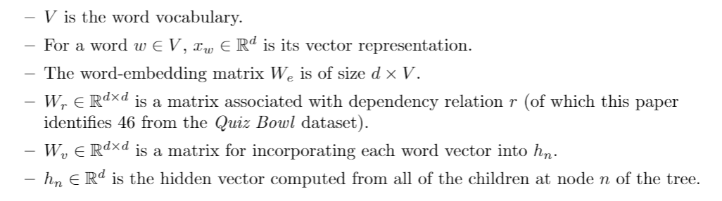
(QANTA): A Neural Network for Factoid Question Answering Over Paragraphs
Iyyer, Mohit et al. “A Neural Network for Factoid Question Answering Over Paragraphs.” 2014.

Slide 55
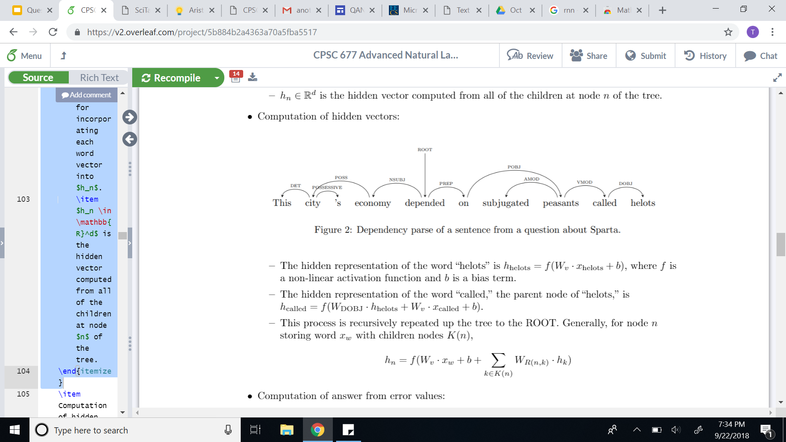
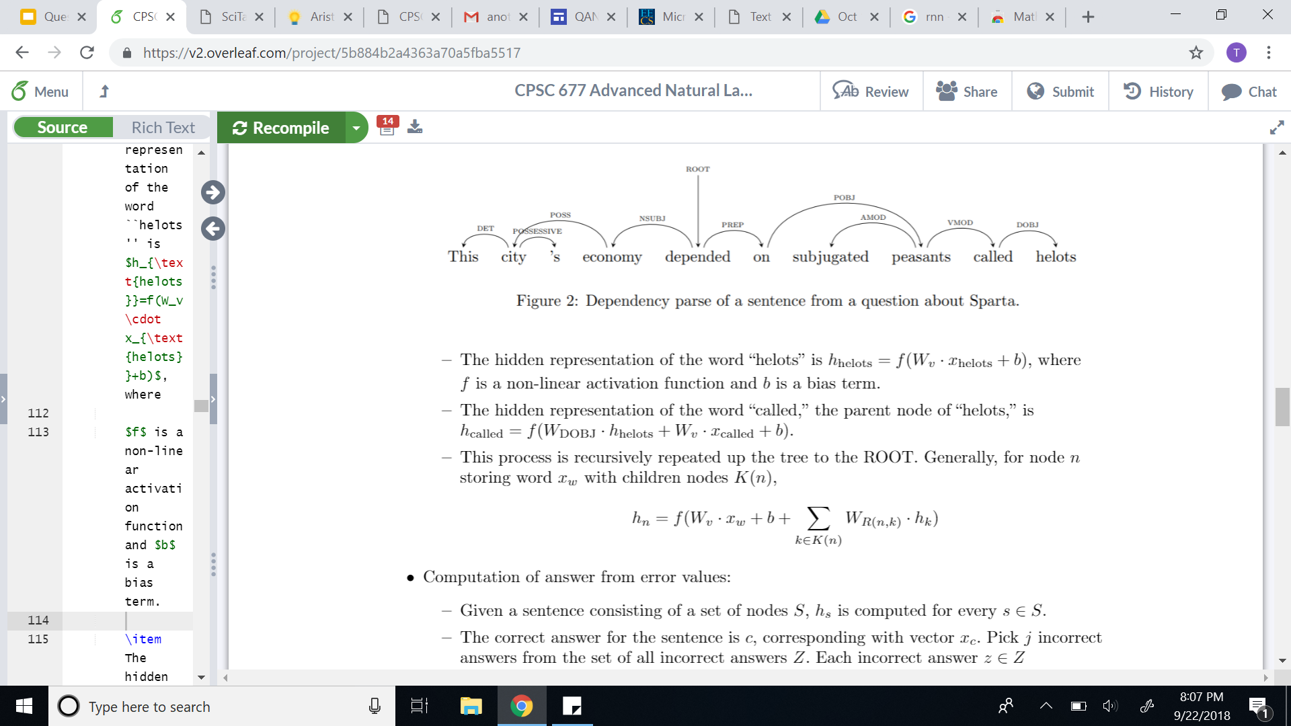
(QANTA): A Neural Network for Factoid Question Answering Over Paragraphs
Recursive computation of hidden vectors:
Iyyer, Mohit et al. “A Neural Network for Factoid Question Answering Over Paragraphs.” 2014.

Slide 56
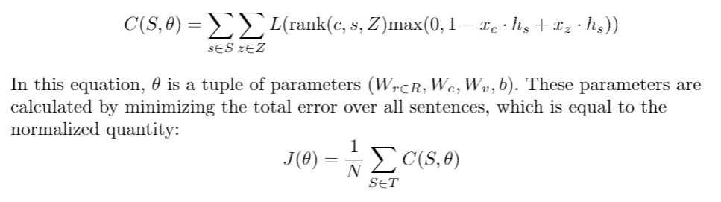
(QANTA): A Neural Network for Factoid Question Answering Over Paragraphs
Computation of parameters from error minimization:
Iyyer, Mohit et al. “A Neural Network for Factoid Question Answering Over Paragraphs.” 2014.

Slide 57
(QANTA): A Neural Network for Factoid Question Answering Over Paragraphs
Experiments:
QANTA was trained on questions used in Quiz Bowl tournaments between 1998 and 2013.
Only questions from the History and Literature sections were used (as these were the largest datasets).
Both questions and answers were altered to make keyword recognition more feasible (using Whoosh).
Iyyer, Mohit et al. “A Neural Network for Factoid Question Answering Over Paragraphs.” 2014.

Slide 58
(QANTA): A Neural Network for Factoid Question Answering Over Paragraphs
Sample QuizBowl question:
These substances can use either using a ping-pong mechanism or a ternary complex intermediate.
https://docs.google.com/viewer?a=v&pid=sites&srcid=d2xwcy5uZXR8d2xocy1xdWl6LWJvd2x8Z3g6Mzk2ZmQ5ZTJiMmRjNzljMg

Slide 59
(QANTA): A Neural Network for Factoid Question Answering Over Paragraphs
Sample QuizBowl question:
These substances can use either using a ping-pong mechanism or a ternary complex intermediate.
One model of them defines the parameters K-m and V-max and uses a steady-state approximation.
https://docs.google.com/viewer?a=v&pid=sites&srcid=d2xwcy5uZXR8d2xocy1xdWl6LWJvd2x8Z3g6Mzk2ZmQ5ZTJiMmRjNzljMg

Slide 60
(QANTA): A Neural Network for Factoid Question Answering Over Paragraphs
Sample QuizBowl question:
These substances can use either using a ping-pong mechanism or a ternary complex intermediate.
One model of them defines the parameters K-m and V-max and uses a steady-state approximation.
They can be inhibited non-competitively and competitively, and the change in their structure during substrate binding is described by the (*) induced-fit model. They can be allosterically regulated and perform their action at their active site. For 10 points, name these proteins that catalyze reactions.
https://docs.google.com/viewer?a=v&pid=sites&srcid=d2xwcy5uZXR8d2xocy1xdWl6LWJvd2x8Z3g6Mzk2ZmQ5ZTJiMmRjNzljMg

Slide 61
(QANTA): A Neural Network for Factoid Question Answering Over Paragraphs
Sample QuizBowl question:
ANSWER: Enzymes
https://docs.google.com/viewer?a=v&pid=sites&srcid=d2xwcy5uZXR8d2xocy1xdWl6LWJvd2x8Z3g6Mzk2ZmQ5ZTJiMmRjNzljMg

Slide 62
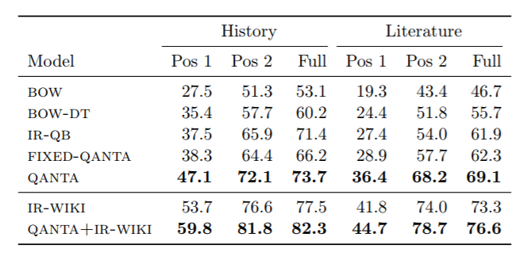
(QANTA): A Neural Network for Factoid Question Answering Over Paragraphs
Performance:
Iyyer, Mohit et al. “A Neural Network for Factoid Question Answering Over Paragraphs.” 2014.

Slide 63
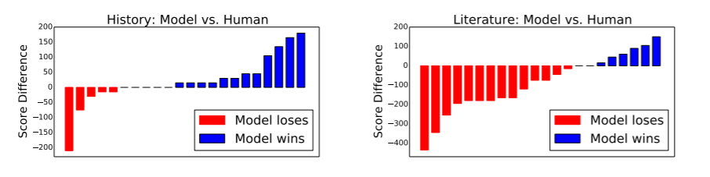
(QANTA): A Neural Network for Factoid Question Answering Over Paragraphs
Performance:
Iyyer, Mohit et al. “A Neural Network for Factoid Question Answering Over Paragraphs.” 2014.

Slide 64
(QANTA): A Neural Network for Factoid Question Answering Over Paragraphs
Summary:
QANTA outperforms BOW and IR models in answering factoid, pyramidal questions.
This paper contributes a model that understands and applies sentence compositionality to question answering.
Iyyer, Mohit et al. “A Neural Network for Factoid Question Answering Over Paragraphs.” 2014.

Slide 65
(SQuAD): 100,000+ Questions for Machine Comprehension of Text
Method:
Develop a set of candidate sentence spans using Stanford CoreNLP.
Apply sliding window approach (Richardson et al.) to get best candidates.
Apply logistic regression model.
Evaluate performance.
Rajpurkar, Pranav. Zhang, Jian. Lopyrev, Konstantin. Liang, Percy. “SQuAD: 100,000+ Questions for Machine Comprehension of Text.” Stanford University, Computer Science Department. 11 October 2016.

Slide 66
(SQuAD): 100,000+ Questions for Machine Comprehension of Text
Logistic regression model:
Candidate answers were evaluated based on certain features.
The model was then trained on the answer choices using AdaGrad (gradient-based optimization algorithm).
L₂ regularization is used in training the model.
Features:
Matching Word/Bigram Frequencies
Root Match
Lengths
Span Word Frequencies
Constituent Label
Span POS Tags
Lexicalized
Dependency Tree Paths
Rajpurkar, Pranav. Zhang, Jian. Lopyrev, Konstantin. Liang, Percy. “SQuAD: 100,000+ Questions for Machine Comprehension of Text.” Stanford University, Computer Science Department. 11 October 2016.

Slide 67
(SQuAD): 100,000+ Questions for Machine Comprehension of Text
Experiments and results:
Used exact match and F1 score to evaluate accuracy.
The results of the logistic regression model were compared with both baseline performance and human performance.
A procedure called “feature ablations” was used to determine on which features the model performed the highest.
The authors also analyzed performance based on answer type.
Rajpurkar, Pranav. Zhang, Jian. Lopyrev, Konstantin. Liang, Percy. “SQuAD: 100,000+ Questions for Machine Comprehension of Text.” Stanford University, Computer Science Department. 11 October 2016.

Slide 68
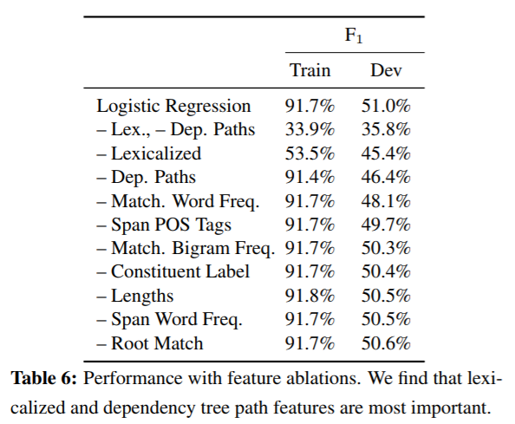
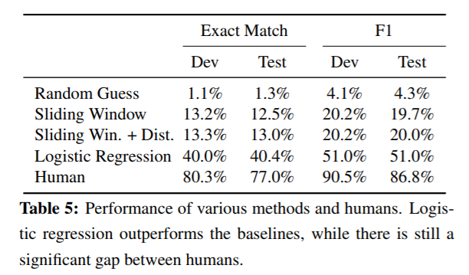
(SQuAD): 100,000+ Questions for Machine Comprehension of Text
Rajpurkar, Pranav. Zhang, Jian. Lopyrev, Konstantin. Liang, Percy. “SQuAD: 100,000+ Questions for Machine Comprehension of Text.” Stanford University, Computer Science Department. 11 October 2016.

Slide 69
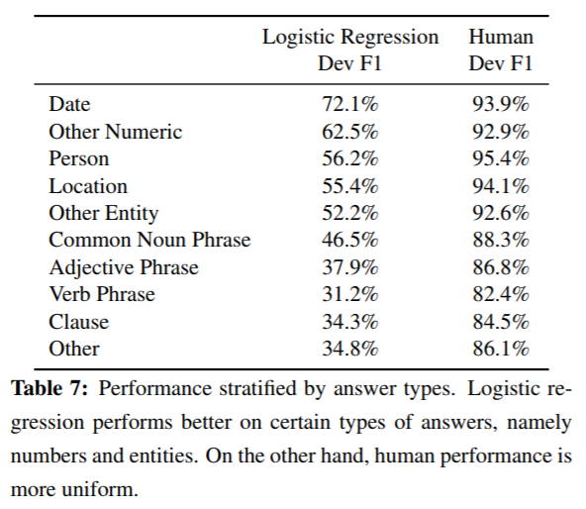
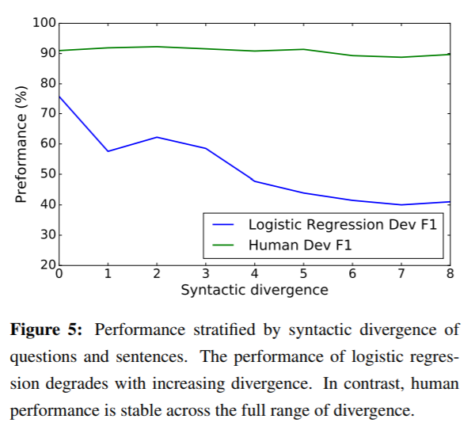
(SQuAD): 100,000+ Questions for Machine Comprehension of Text
Rajpurkar, Pranav. Zhang, Jian. Lopyrev, Konstantin. Liang, Percy. “SQuAD: 100,000+ Questions for Machine Comprehension of Text.” Stanford University, Computer Science Department. 11 October 2016.

Slide 70
(SQuAD): 100,000+ Questions for Machine Comprehension of Text
Summary:
This paper contributes a question answering dataset based on Wikipedia articles that has crowdsourced question-answer pairs.
This dataset is public and many other papers use it to test their own models.
The logistic regression model outperforms the baseline, but is far from human performance.
However, since the paper was published in 2016, the gap between this model’s performance and human performance has more than halved.
Rajpurkar, Pranav. Zhang, Jian. Lopyrev, Konstantin. Liang, Percy. “SQuAD: 100,000+ Questions for Machine Comprehension of Text.” Stanford University, Computer Science Department. 11 October 2016.

Slide 71
NLP

